Slide 2
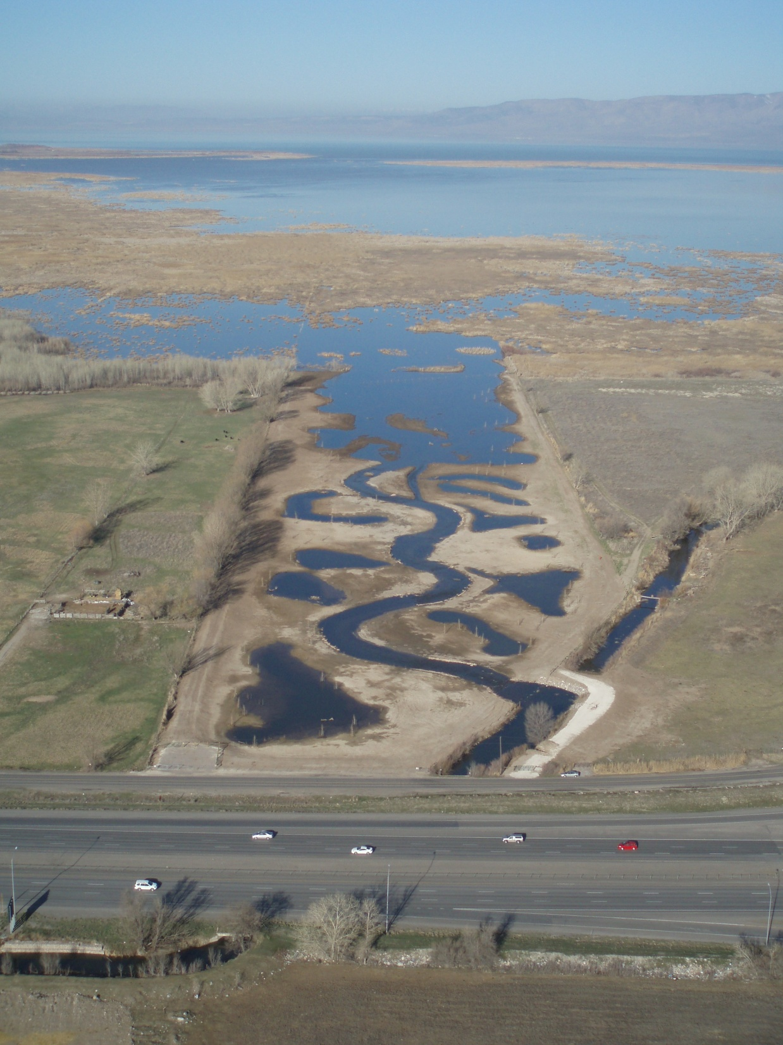
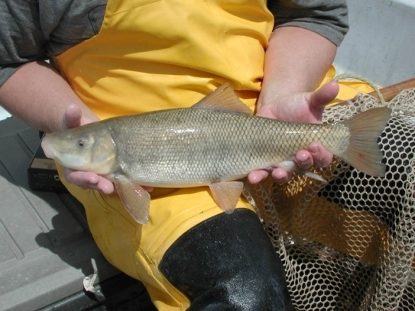
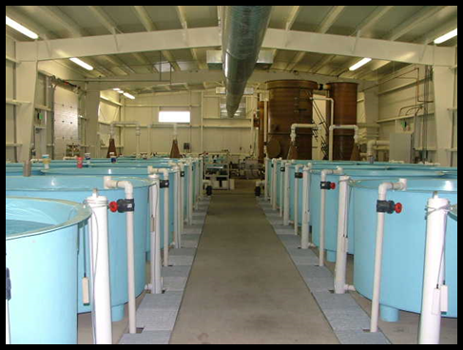
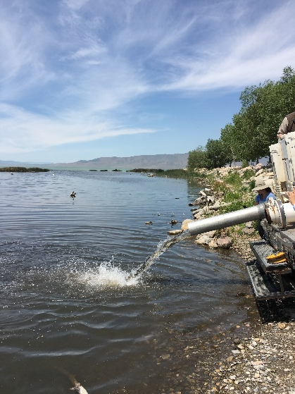
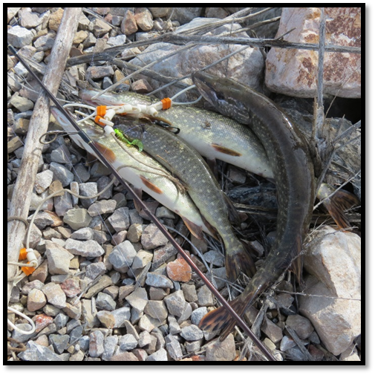
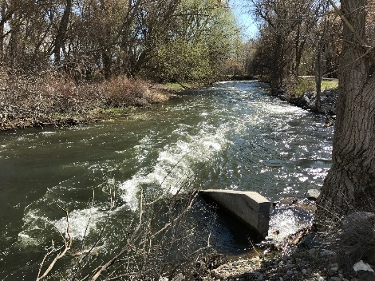
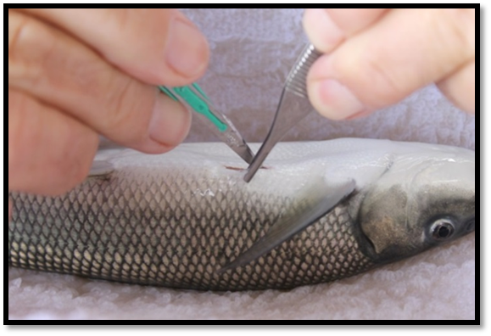
June Sucker Recovery Implementation Program
Cooperative effort between state, federal, and local agencies
Comply with the Endangered Species Act (Sufficient Progress)
Ecosystem approach to recovery
Notes:
Six recovery elements: Non-native and sportfish management, water management and protection, genetic integrity and augmentation, habitat development and maintenance, research and monitoring, information and education
All partners participate at various funding levels and provide representative to Program committees

Slide 3
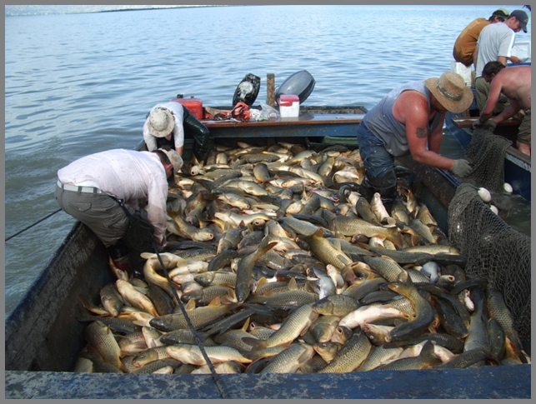
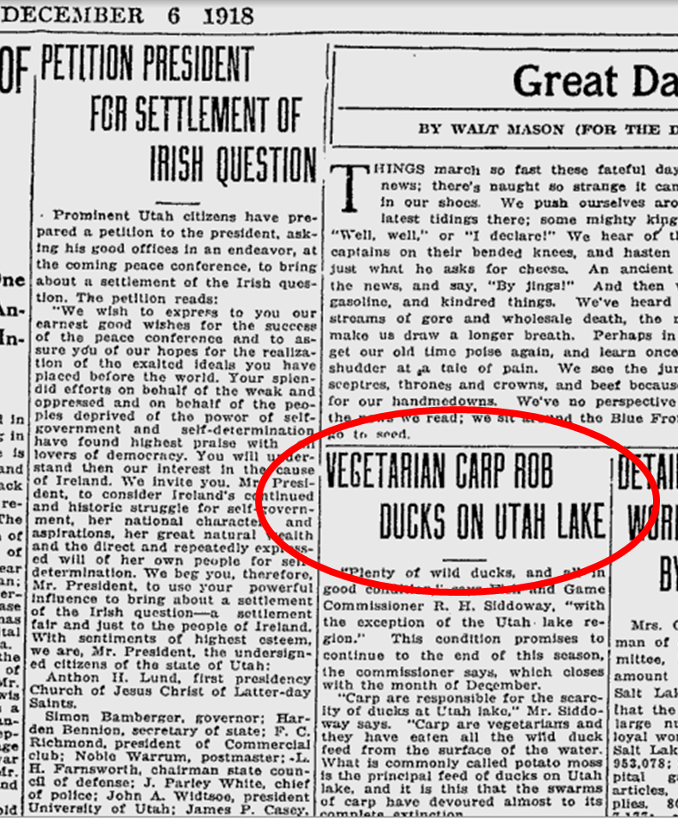
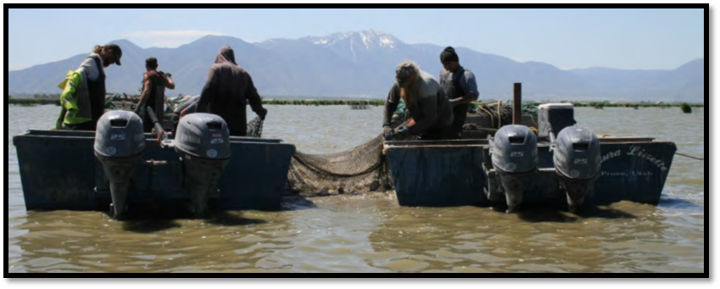
Background
Common Carp
Introduced into the Utah Lake watershed
Dominates the Utah Lake fish community
Loss of refuge habitat

Slide 4
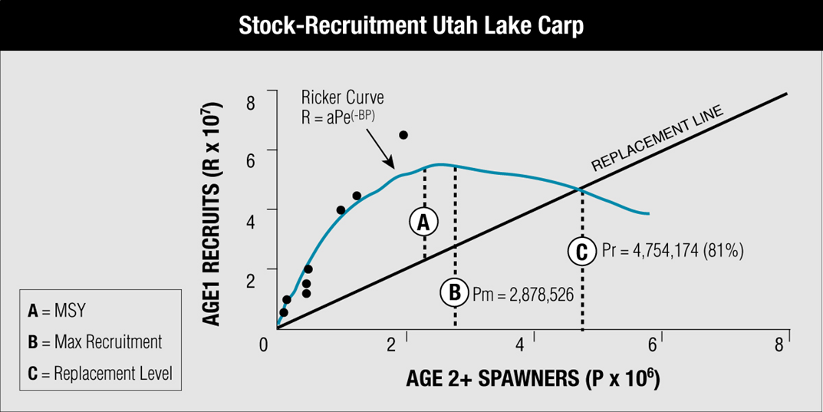
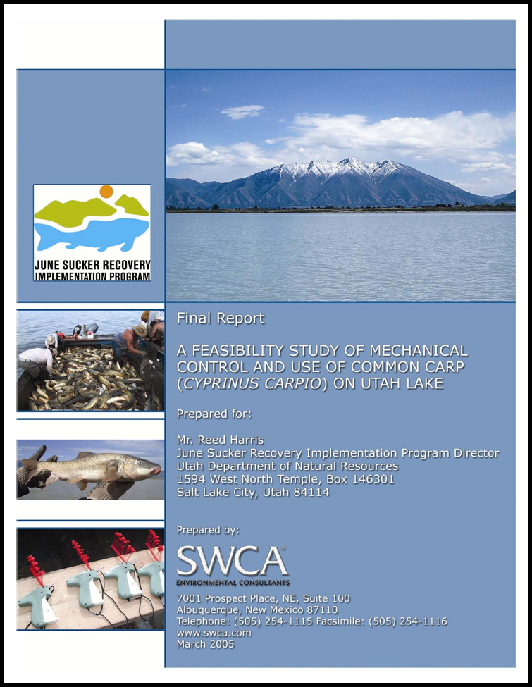
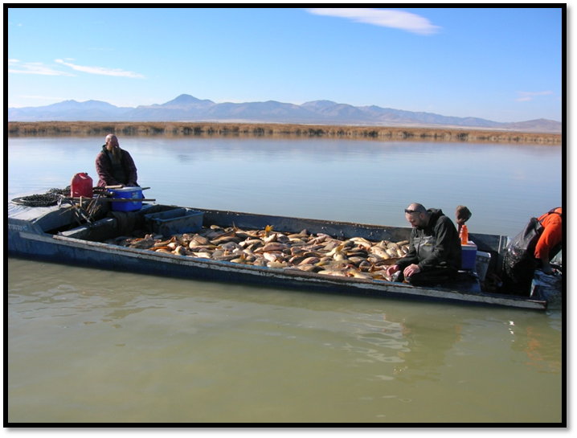
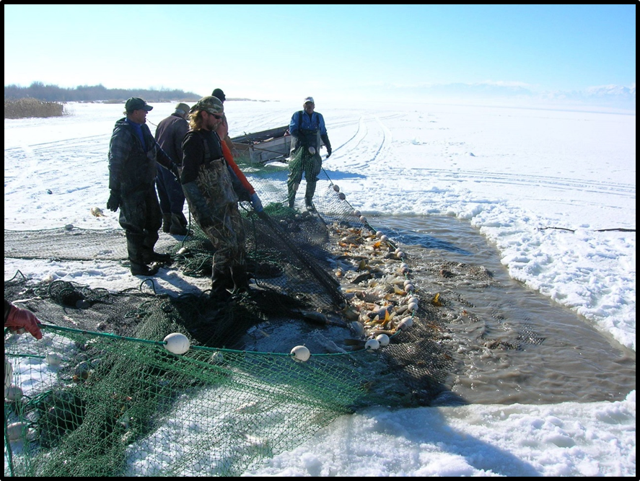
Background
Series of carp removal feasibility studies, market analysis, and pilot projects

Slide 5
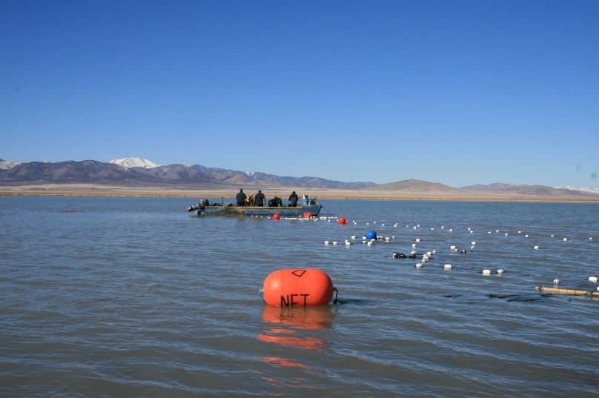
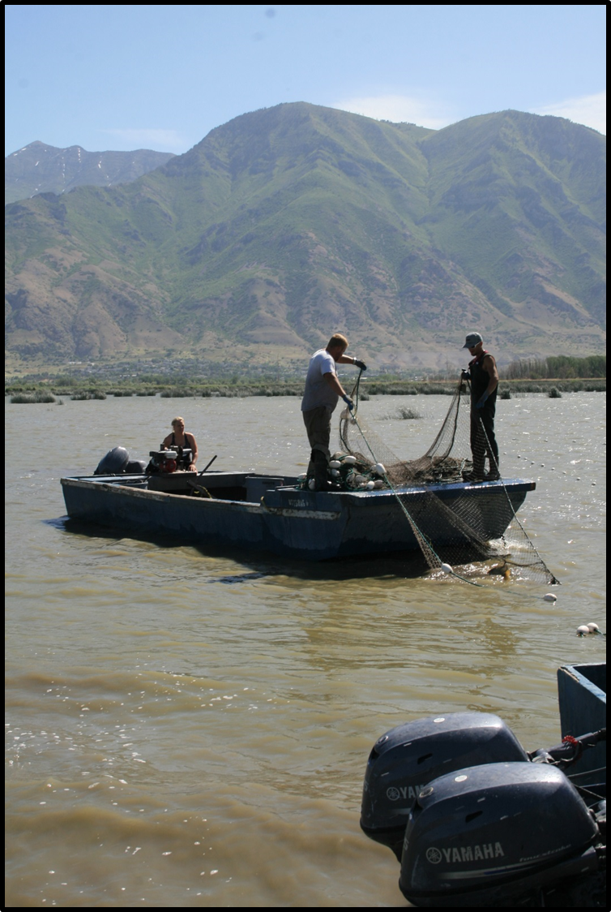
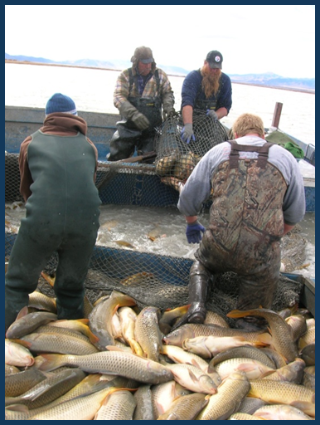
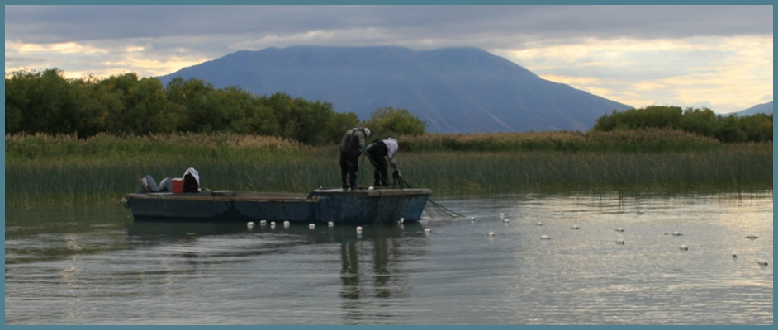
Removal Program Started September 2009
Over 24 Million pounds removed through Dec 2016
Notes:
5

Slide 8
Carp Standardized Seining
North East (1E)
2012: 24 carp/acre
2016: 12.5 carp/acre

Slide 9
Carp Standardized Seining
6.9 lbs
6.5 lbs
6.5lbs
6.0 lbs
5.8 lbs

Slide 10
Carp Standardized Seining
North East (1E)
2012: 120 lbs/acre
2016: 77 lbs/acre

Slide 11
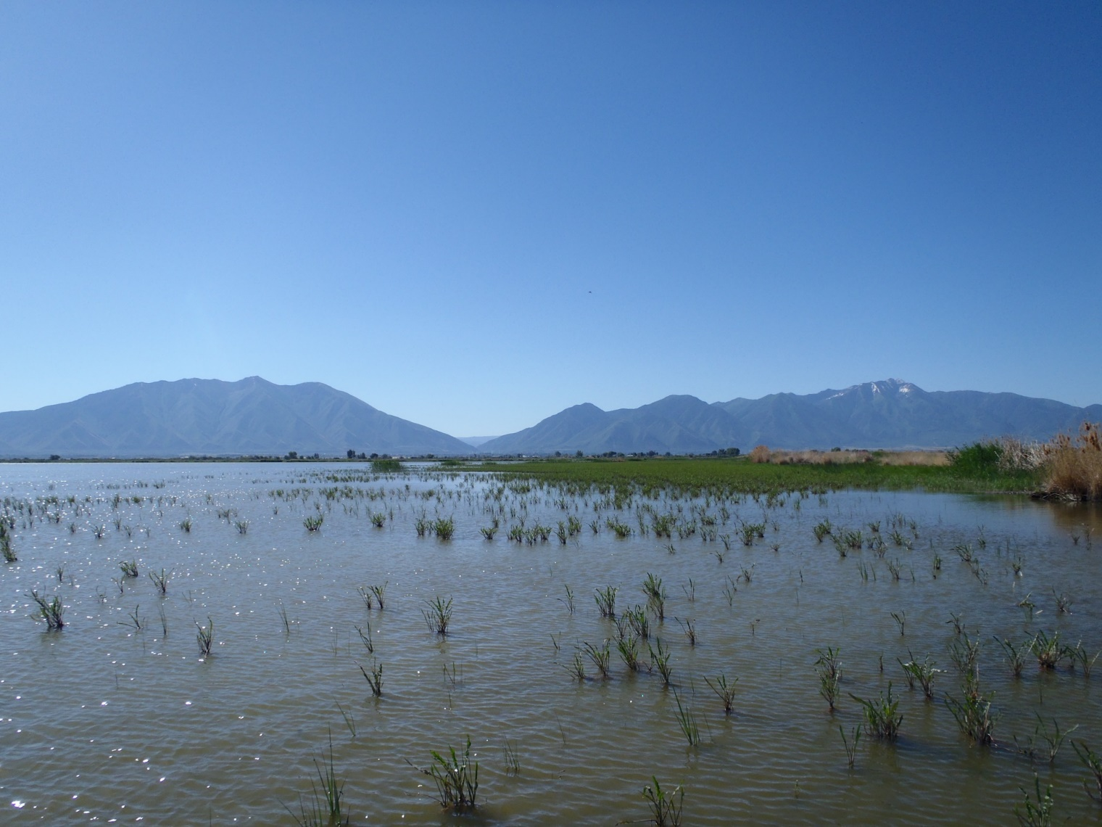
Spring 2016 = 4 eastern lake-wide locations with new mixed vegetation habit: Alkali bulrush, curly dock, sago pondweed (sparse)

Slide 12
Macrophyte results, June 2016

Slide 13
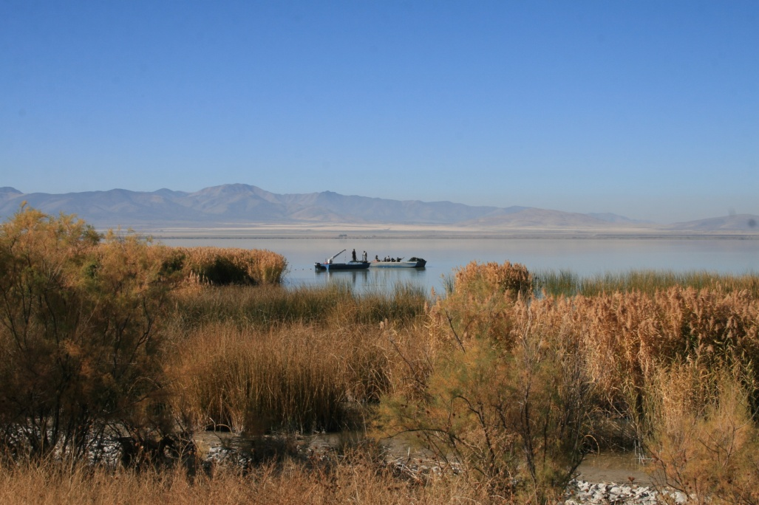
Questions???
Notes:
13

